Slide 1
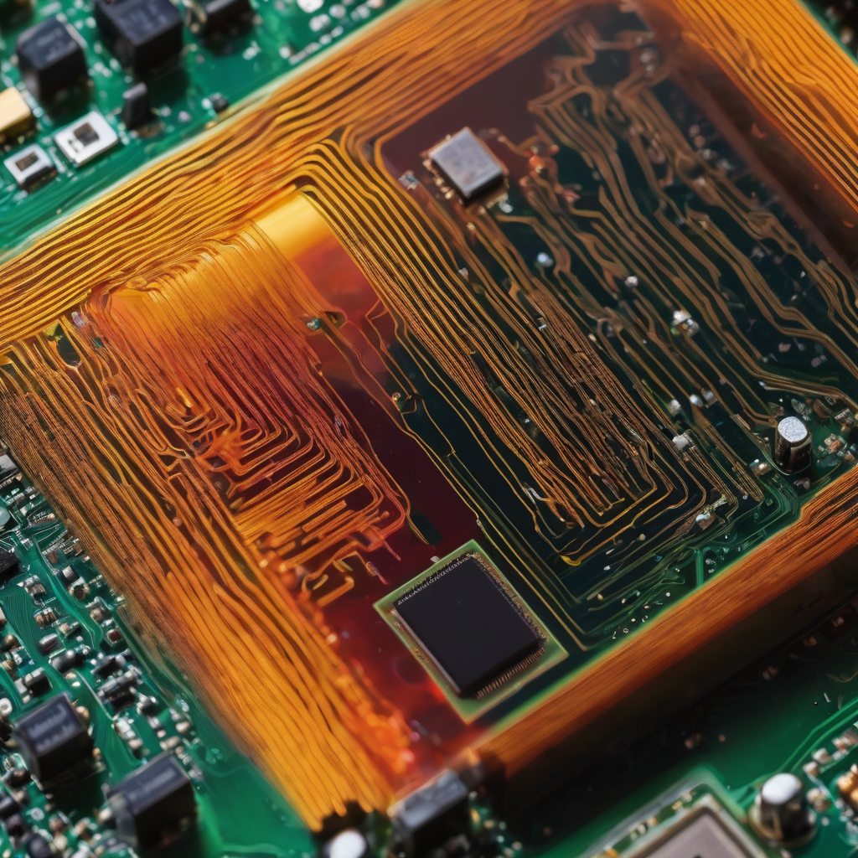
PWM Drawer Embedded C Graduation Project
IG
by: Ibrahim Mohammed Ibrahim Gabr
Created at: 30/9/2023

Slide 2

Introduction to PWM
1
What is PWM?
PWM, or Pulse Width Modulation, is a technique used to manipulate the width of a signal to control the power delivered to a specific device or system.
2
Overview of Applications
PWM finds its applications in various fields such as Motor Control, LED Brightness Control, Audio Amplification, Voltage Regulation and …etc.

Slide 3
Needed components
Hardware version Components
Simulation version Components
The project needed a micro-controller, we used ATMEGA32A which already have dedicated hardware modules for generating PWM signals.
We also used LCD (LM01602A- 2*16) 4 bits to display the wave form and details.
We also used two buttons to control duty cycle for changing wave form view.
We will use same components like hardware version but different LCD with bigger size (4*20) for better view.

Slide 4
Working Principle of PWM in Embedded C
1
Configure Timer/Counter
Configure a timer/counter peripheral in the microcontroller. Then set the timer's prescaler, mode (often PWM mode), and the desired frequency
Calculate and Set the PWM Duty Cycle
2
Calculate the desired duty cycle. The duty cycle value typically ranges from 0 (0% DC) to max value (100% DC). For example, if 50% DC needed, setting DC value to half the max value
3
Load Duty Cycle Value
Loading the calculated duty cycle value into the timer/counter's Compare Register or Output Compare Register. This value determines the point at which the PWM signal transitions from high to low (or vice versa) within each PWM period.
Advantages of Embedded C for PWM
4
Starting or enable the timer. It will count up from zero and compare its count value with the duty cycle value set in the Compare Register

Slide 5
Working Principle of PWM in Embedded C
5
Generate PWM Signal
As the timer counts up, it generates the PWM signal. When the timer's count matches the value in the Compare Register, the PWM signal changes state (high to low or low to high), depending on the timer's configuration
Repeating
6
The timer continues to count, and the PWM signal repeats with the specified frequency and duty cycle. This generates the PWM waveform which we need to draw.

Slide 6
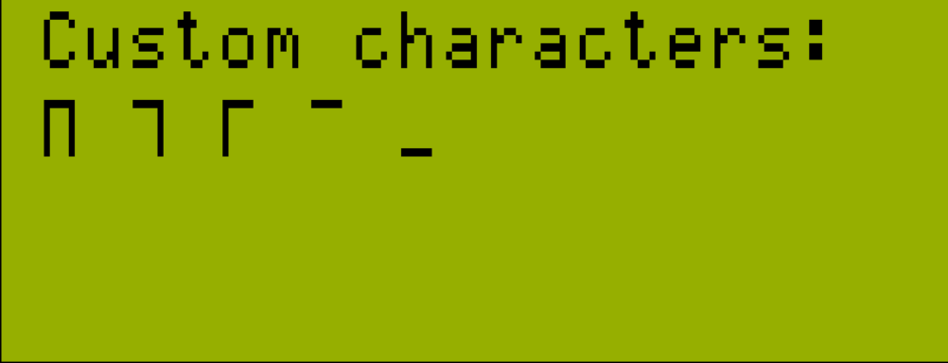
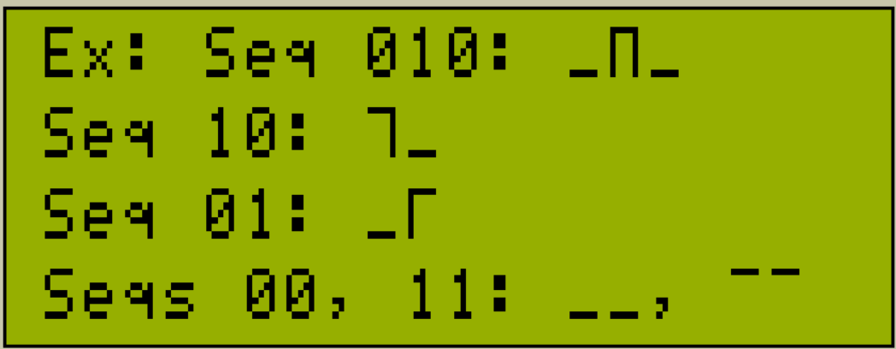
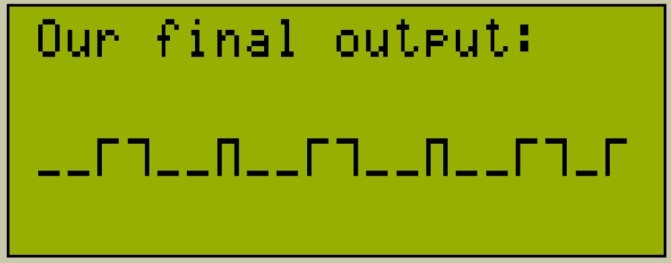
Drawing the generated wave
We will draw the generated wave
on LCD by:
Getting the PWM wave from its output pin.
The wave or signals output is a series of 0 (OFF or LOW) and 1 (ON or HIGH).
We will then store that series depending on our screen size.
Then declaring 5 custom characters as shown.
Each sequence of signals will be represented with a suitable sequence of chars as shown.
These continuous sequences of characters will finally form our desired wave.

Slide 7
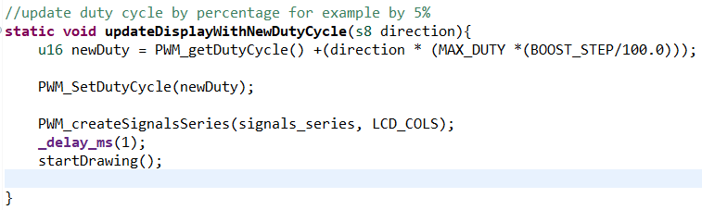
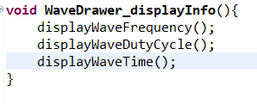
Software Implementation
Some important methods we created
in code:
WaveDrawer_displayInfo: this method displaying the wave info which are duty cycle frequency and time.
WaveDrawer_draw : this method uses the custom characters and known sequences to draw the wave.
updateDisplayWithNewDutyCycle: this method updates the whole view when duty cycle changed by integrated control buttons.
All LCD based methods have two versions, hardware and simulation.

Slide 8

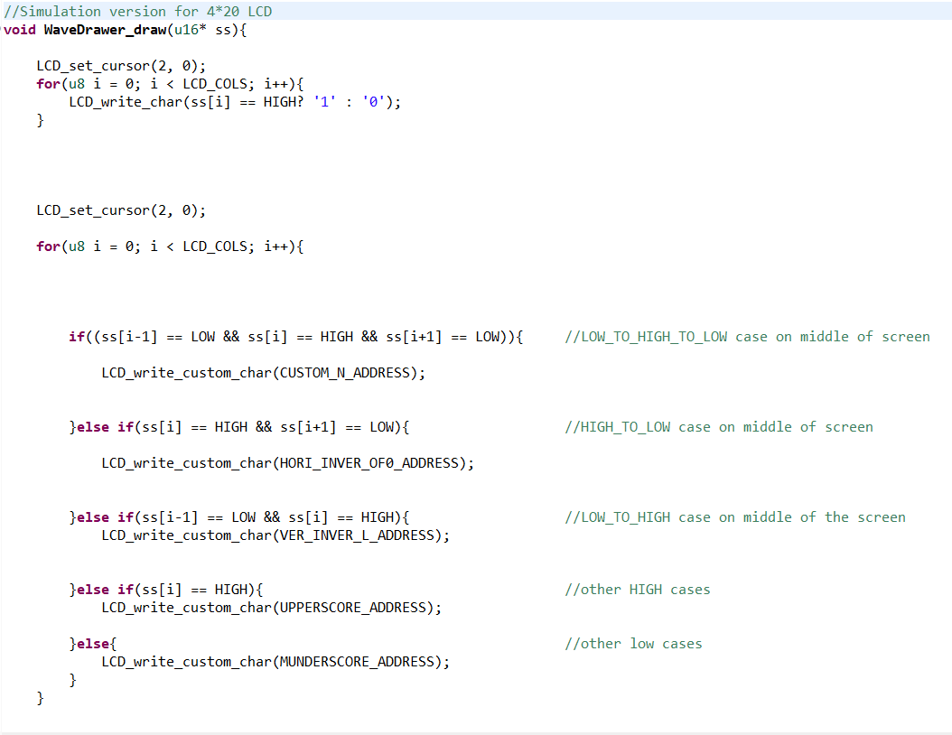
Software Implementation

Slide 9
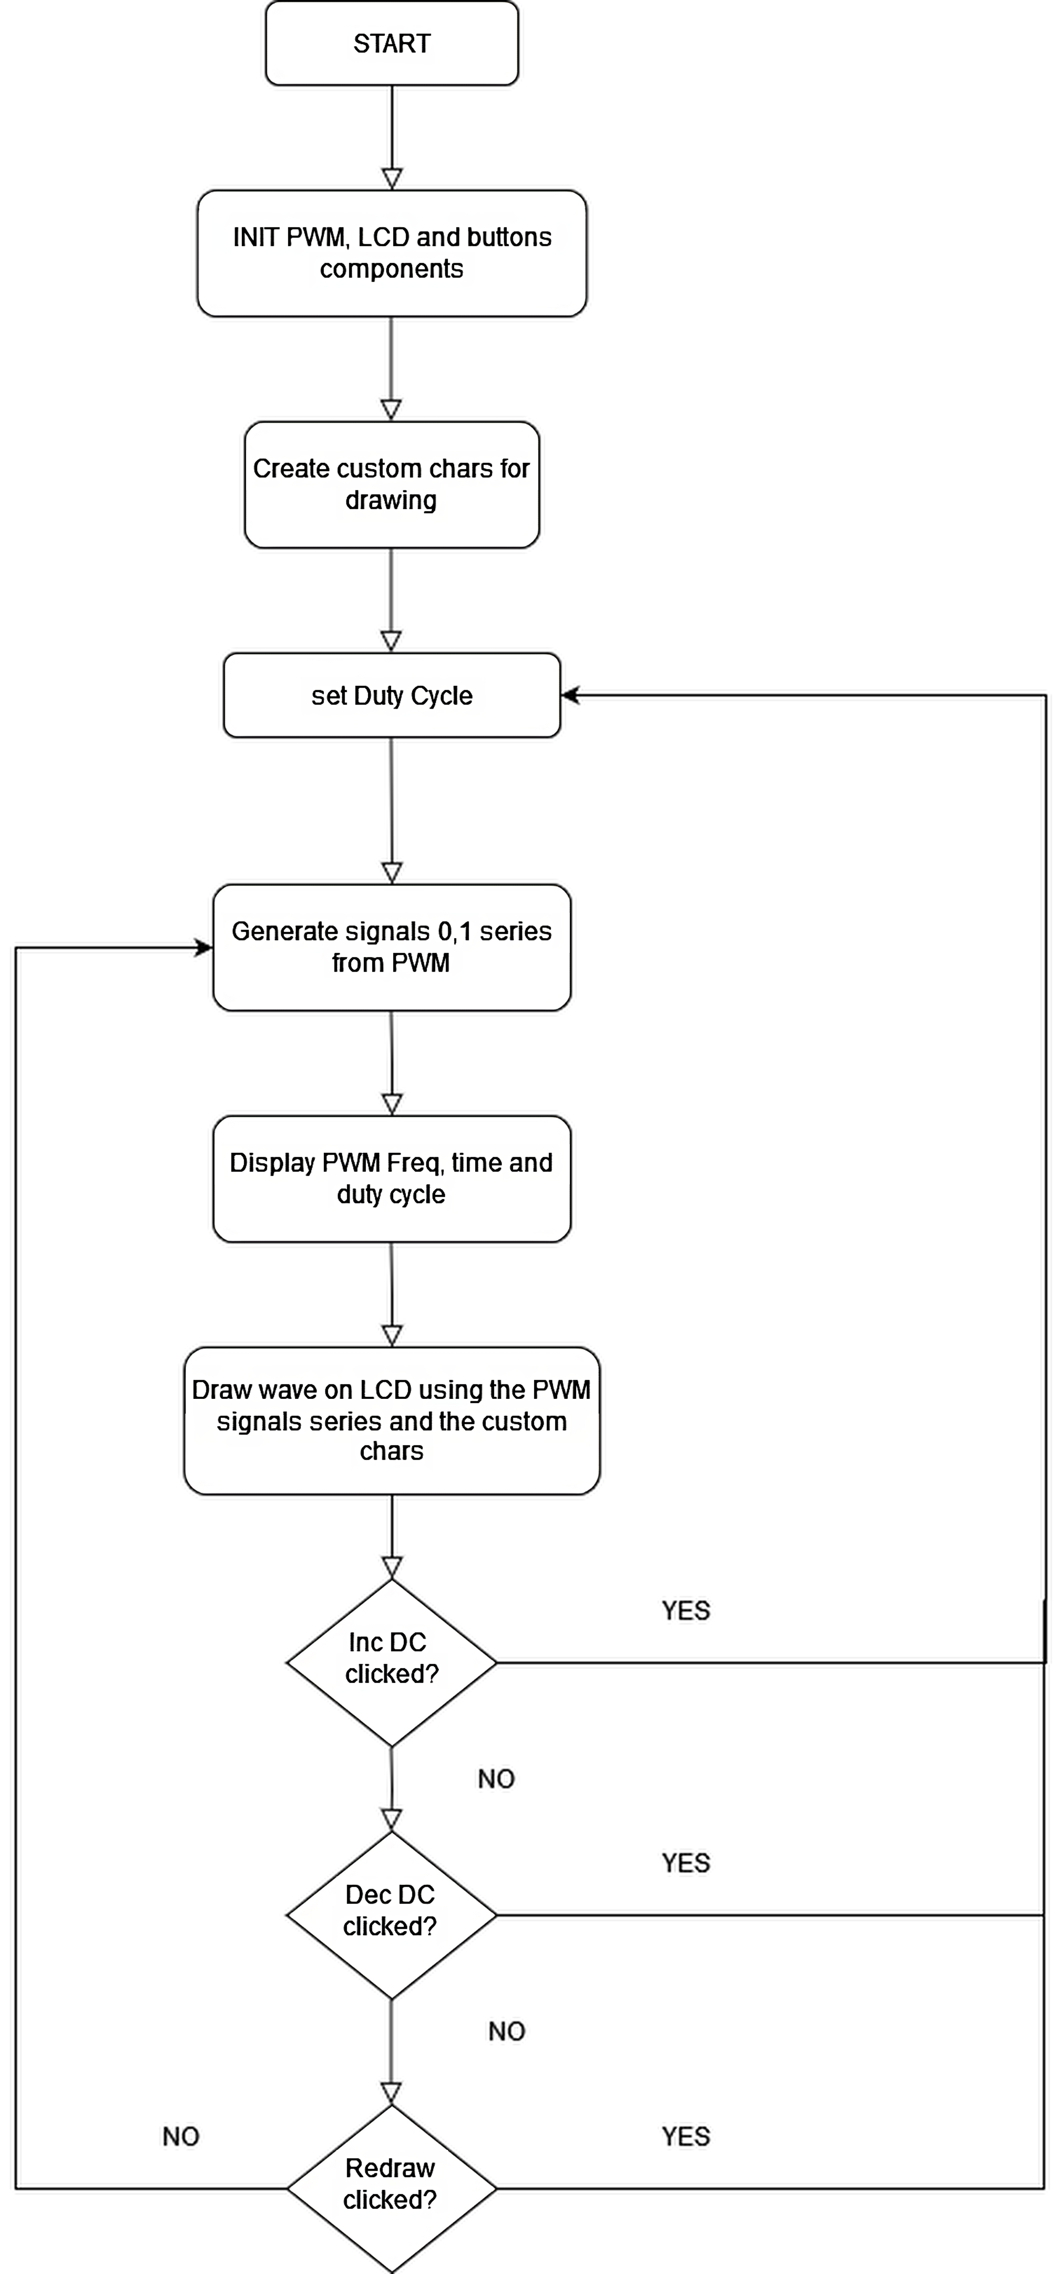

Slide 10
Features and improvements
No Graphical LCD needed
Displaying signal sequence
This PWM drawer able to work with any simple LCD and doesn’t need any special type or Graphical LCD.
PWM drawer simulation version also displays the PWM signals sequence for example: 011000… and so on, for better demonstration of PWM working.
Extra controllers
There are also 3 extra controllers buttons for increasing and decreasing duty cycle and refreshing view with new signals to demonstrate wave in many forms.

Slide 11
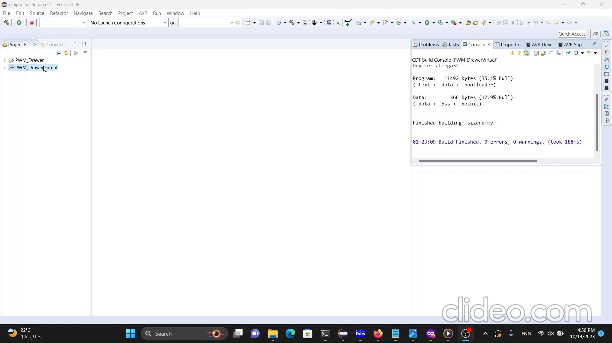
Testing and Results Simulation

Slide 12
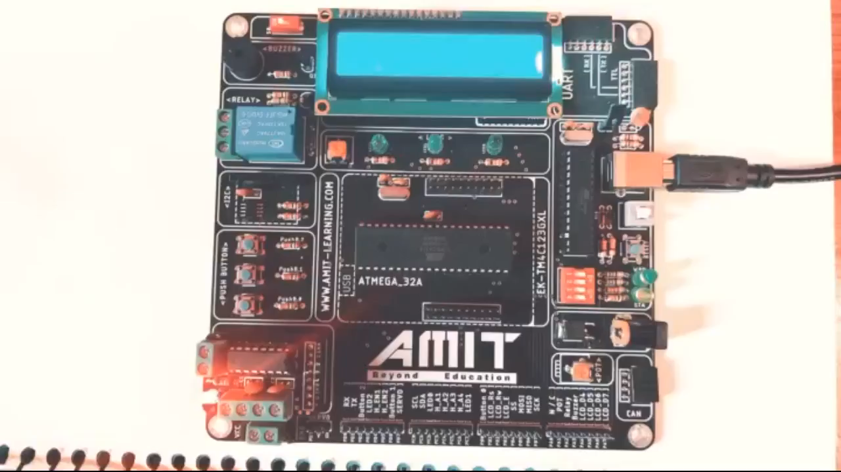
Testing and Results Hardware

Slide 13
Conclusion and Future Prospects
My PWM drawer project has successfully demonstrated the effective control of pulse width modulation in graphical display. This project showcases my understanding of embedded system fundamentals and my ability to apply this knowledge to practical applications. Finally, I've gained valuable hands-on experience in developing and implementing PWM drawer.

